Slide 1
Creating Fields, Site Columns and Content Types
The Basic Building Blocks of Data Structures in SharePoint
Notes:
In this module you’ll learn how to create custom field types, field controls, site columns and content types as well as how to leverage them in custom solutions. In addition, you’ll also learn how to implement them in a repeatable fashion with the SharePoint tools in Visual Studio 2010.

Slide 2
Agenda
Site Columns
Content Types
Custom Field Types
Custom Field Controls

Slide 3
Site Columns
Reusable column template for use within lists and content types
Specify:
Name & description
Data type
Site column group
Scoped at the site level
Available to child sites
Adding to a list / content type creates a copy
To manage, must have Web designer rights
Notes:
Lists store data in columns, also referred to as fields. You can create the fields in the context of your list, but you can also create site columns that can be reused in multiple lists.
Site columns are created at the level of the site collection and are available to all the sub sites. When creating a site column you have to specify a name, a data type and the name of a group.

Slide 4
Creating & Managing Site Columns
Create / manage many ways:
Browser-based user interface
SharePoint Designer 2010
SharePoint object model
Feature XML <Field>
Features & object model provide most control
Easy to version in virtually all source control systems
Highest level of reuse
Notes:
You can create site columns in many different ways:
Create them in the user interface: navigate to the Site Settings page of the root site and click the Site Columns hyperlink under the Galleries group.
Use SharePoint Designer 2010.
Use the SharePoint object model to create a site column programmatically.
Use CAML to create a site column declaratively using the <Field> element.

Slide 5
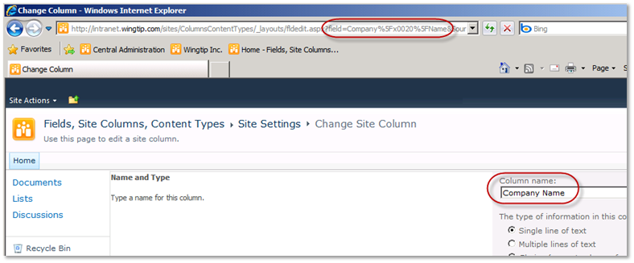
The Feared & Dreaded _x0020_ !!!
When creating columns with spaces in the names, the internal name (ID) converts spaces to encoded spaces (x0020)
To avoid this, explicitly set the internal name within a the XML definition
URL Encoded version of Company_x0020_Name
Notes:
You can create columns in the user interface of SharePoint. To have a user friendly name, in general you enter a name with spaces. When saving your column, SharePoint translates this column name to a name with encoded spaces.
For example: Company Name will be translated to an internal name of Company_x0020_Name. To avoid this, you can explicitly set the internal name within an XML definition:
<Field ID=“{C2A8588A-F8A2-4324-BE39-4962E2E75895}”
Name=“CompanyName“ DisplayName=“Company Name” Type="Text">

Slide 6
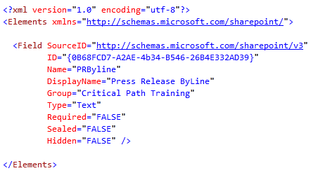
Creating Site Columns with Features
Notes:
This code sample demonstrates how to create a custom field in XML. Important properties are:
ID: must be a unique GUID.
DisplayName: is the user friendly name that will be displayed in the user interface.
Name: is the internal name.
Type: the data type of the column.
Required: indicates whether the column is required or optional.
Group: the group is which the custom column will be shown.
Hidden: indicates whether the column is hidden to the user or not.
ReadOnly: can only be updated through the API or definition (XML).
Sealed: can only be updated through the definition (XML).

Slide 7
Agenda
Site Columns
Content Types
Custom Field Types
Custom Field Controls

Slide 8
Content Types
Used to define a type of data
Enable storage of different types of content in same list or library
Specify:
Name & description
Site columns, workflows, event receivers, policies, etc.
Content type group
Scoped at the site level
Available to child sites
Adding to a list creates a copy
To manage, must have Web designer rights
Notes:
Content types are designed to help users organize their SharePoint content in a more meaningful way. A content type is a reusable collection of columns, a data structure, that can be applied to several lists or document libraries in the site collection.
You can also apply more than one content type to the same list or library, enabling users to store multiple different types of content in the same list or library.
Each content type can include different columns for gathering and storing item metadata, and can have different workflows assigned to them.
Content types are defined at site collection level but are available to all sites and sub sites in the site collection.

Slide 9
Creating & Managing Content Types
Create / manage many ways:
Browser-based user interface
SharePoint Designer 2010
SharePoint object model
Feature XML <ContentType>
Features & object model provide most control
Easy to version in virtually all systems
Highest level of reuse
Notes:
As with site columns, you can create site columns in many different ways:
Create them in the user interface: navigate to the Site Settings page of the root site and click the Content Types hyperlink under the Galleries group.
Use SharePoint Designer 2010.
Use the SharePoint object model to create a content type programmatically.
Use CAML to create a content type declaratively using the <ContentType> element.

Slide 10
Inheriting Content Types
Allows base definition reuse across multiple types
Core properties can be defined in base content types
The Base content type is inherited by more specific content types
Base Document
Wingtip Document
Wingtip Proposal
Wingtip Presentation
Notes:
You can define a content type with several columns and use it as a base for other content types. More specific content types can inherit the base content type and add more specific columns to it.

Slide 11
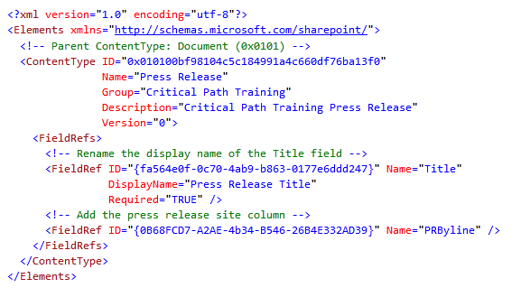
Creating Content Types with Features

Slide 12
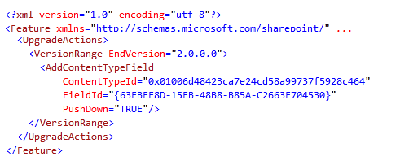
Upgrading Content Types
Upgrading content types has always been hard
New <UpgradeActions> element in Feature schema
One of the action is <AddContentTypeField>
Enables developers to easily upgrade content types
Notes:
In SharePoint 2007 it is not easy to upgrade the definition of existing content types.
SharePoint2010 adds new elements to the CAML schema that allows for a better upgrade scenario. You can use the <UpgradeActions> element within the <Feature> element to indicate that you want to upgrade a feature. Within the <UpgradeActions> element you can place elements like <AddContentTypeField> to add a new field to a provisioned content type and to propagate the change to child lists and content types.

Slide 13
Upgrading Content Types – Special Note
Upgrading content types should be thoroughly tested in each scenario
Strongly recommended to read the following resources:
Patterns & Practices: SharePoint 2010 Guidance http://msdn.microsoft.com/en-us/library/ff770300.aspx
P&P: SP2010 Guidance: Columns, Lists & Content Types http://msdn.microsoft.com/en-us/library/ff798404.aspx
MSDN Documentation: Updating Content Types http://msdn.microsoft.com/en-us/library/aa543504.aspx
Notes:
The process of upgrading existing content types has been a dynamic challenge since they were introduced in SharePoint 2007. While the new upgrade actions are quite helpful and updating content types through the browser is straightforward and reliable, it is strongly recommended that developers review the documentation links in this slide. There are so many different scenarios and conditions that could happen that it is best for developers to get a solid understanding of what options are available, what are the advantages and disadvantages of each and come up with their own process.

Slide 14
DEMO
Creating Site Columns & Content Types

Slide 15
Agenda
Site Columns
Content Types
Custom Field Types
Custom Field Controls

Slide 16
Understanding the Problem
At times the included SharePoint field types do not meet business requirements for:
Storage of data elements
Pull data from external systems & not rely on users to type the customer ID (preferred: select from a list of IDs)
Performing validation on data entry / edits
Notes:
These custom field types can include extra data validation needed by the business, but also custom field rendering to make data entry easier/clearer to the user or make it more attractive.

Slide 17
SharePoint Version Implications
SharePoint Foundation 2010
Can create custom field types with optional field controls
Can be used in site columns & list columns
SharePoint Server 2010
Same as SharePoint Foundation, except…
In Publishing (WCM) sites, can create custom field controls and wire them up to existing field types
Done in template pages (aka: page layouts)
Notes:
SharePoint Foundation 2010 enables you to create custom field types with optional field controls. These custom field types can be used in site columns and in list columns.
SharePoint Server 2010 adds the possibility to create custom field controls and use these controls in existing field types. This can be achieved in template pages.

Slide 18
Custom Field Types
SharePoint provides a way to create custom field types
Allows developers to define:
Structure of the stored data
Rendering of the field in display / new / edit mode (as well as alternate rendering based on the context, such as a mobile device)
Custom validation
Custom default values for new items
Notes:
Custom field types allow developers to:
Define a structure for the data to be stored.
Rendering of the field. This rendering can be different in new, edit and display mode.
Add custom validation that is needed by the business requirements.
Define default values for the new items.

Slide 19
Custom Field Type
WingtipField.dll GAC
SharePoint
Field Value
Field Type Definition
Field Type
fldtypes_Wingtip.xml [..]\14\TEMPLATE\XML
Field Control
Field Mobile Control
Field Rendering Control
Field Mobile Rendering Control
WingtipFieldControl.ascx [..]\14\TEMPLATE\CONTROLTEMPLATES
WingtipFieldMobileControl.ascx [..]\14\TEMPLATE\CONTROLTEMPLATES
Notes:
A custom field type consists of different parts:
The field type definition is an XML file containing CAML markup that is stored in the 14\TEMPLATE\XML directory of SharePoint. The files must be prefixed with fldtypes_ to make SharePoint aware of the custom field type. This XML contains meta information about the field type, as well as a pointerto the class, and assembly containing the class, that defines the custom field type. SharePoint looks at all the field type definition files on the server when it initally loads to generate a list of valid field types.
The field type itself is defined in an assembly that must be dropped in the Global Assembly Cache. It consists of at least the Field Type class that inherits from an existing SharePoint type. This class is what SharePoint looks to for everything related to the custom field type. If a Field Value class is available, the Field Type class will contain a reference to this class. The same counts for the Field Control class: if such a class is available, the Field Type class will contain a reference to this class.

Slide 20
Creating Custom Field Types Requirements
Create a custom field type class inheriting from a base field type class:
Must be deployed to GAC as a strong-named assembly
Create a field type definition:
XML file making SharePoint aware of the field type
Contains pointer to class & assembly containing type
Contains rendering logic & default values
SPFieldBoolean | SPFieldMultiChoice | SPFieldText
SPFieldChoice | SPFieldMultiLineText | SPFieldUrl
SPFieldCurrency | SPFieldNumber | SPFieldUser
SPFieldDateTime | SPFieldRatingScale | SPFieldMultiColumn
SPFieldLookup
Notes:
The custom field type class must always inherit from a base field type class like (SPFieldText).
The field type definition is an XML file that containsthe metadata that Windows SharePoint Services needs to be aware of the custom field type.
It contains information about the assembly that includes the compiled field type.
It is typically also used to render the field on the view list item page and to specify default values.
It can also declare and define special variable properties of the field type whose values will be set whenever a column is created based on the field type.

Slide 21
Custom Field Value
WingtipField.dll GAC
SharePoint
Field Value
Field Type Definition
Field Type
fldtypes_Wingtip.xml [..]\14\TEMPLATE\XML
Field Control
Field Mobile Control
Field Rendering Control
Field Mobile Rendering Control
WingtipFieldControl.ascx [..]\14\TEMPLATE\CONTROLTEMPLATES
WingtipFieldMobileControl.ascx [..]\14\TEMPLATE\CONTROLTEMPLATES
Notes:
If the field type stores data within a custom data structure (rather than a simple string), the assembly will contain a Field Value class and the field type class will contain a reference to this Field Value class.

Slide 22
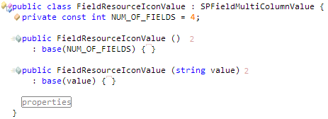
Custom Field Values Type
When base field types do not support a special data structures required by your custom field type, you can create your own
Requirements:
Must be serializable – should implement ToString()
Must implement two constructors (can simply call the base value type class):
Notes:
The Field Value class always inherits from an existing SharePoint field value type, like f.e. SPFieldMultiColumnValue.
The custom field value class must know how to serialize and deserialize the data. The class typically implements two constructors that call the base value type class.

Slide 23
Custom Field Values Type (ctd.)
Custom field type values require overriding one method on the field type class:
GetFieldValue()
Called when SharePoint makes a call to SPListItem[“CustomFieldType”]
Notes:
A Field Value class must be associated with the field type class. To make the custom field type class aware of the custom value type, you must override the GetFieldValue() method. This method should return an instance of the value type. This method is called when code calls the SPListItem[“customFieldType”].

Slide 24
Customizing Behavior of Custom Field Types
GetFieldValueAsText(), GetFieldValueAsHtml() & GetFieldValueAsEdit()
Returns the field as either text / HTML or for editing
GetFieldValue()
Use this when the type contains a custom value type
IDesignTimeHtmlProvider.GetDesignTimeHtml()
Used to display the field type in design mode (SPD)
OnAdded / OnUpdated / OnDeleting
Events enabling developers to add custom logic on conditions
Notes:
As explained in previous slide, you can override the GetFieldValue() method if your custom field type contains a custom Field Value class.
In the Field Type class, you can also override the method GetFieldValueAsText() method if you want to return the field value as plain text. If you want to return the field value in HTML format, you can override the GetFieldValueAsHtml() method.
You can also implement the OnAdded, OnUpdated and/or OnDeleting events to add custom logic:
The OnAdded event occurs after a field of this type is added.
The OnUpdated event occurs after changes are made to the field schema.
The OnDeleting event occurs after a field is being deleted. You can provide custom logic that runs before deletion of the custom field.

Slide 25
Validating Custom Field Types
Validation can be defined in rendering control using ASP.NET 2.0 validation controls
Downside: bypassed when working with the field through code
Can override the GetValidatedString() method on the custom field class
If data is not valid, throw exception of type SPFieldValidationException
Make sure to include logic if the field is required (indicated by the Required property on the base field class)
Notes:
Developers have two options in implementing validation of the data in the custom field type:
Through the use of ASP.NET 2.0 validation controls. This method bypasses the validation when the developer writes code that interacts with the field through code.
Implement server-side validation within the field type itself by overriding the GetValidatedString() method on the Field Type class. This validation will be executed both when the field is accessed throught the API or when a user interacts with the field in the web interface.
If the data is not valid, throw an exception of type SPFieldValidationException. SharePoint will display a user-friendly exception message, containing the message provided as a parameter when the exception is thrown.
In this method you must also include the necessary logic when the field is set as required.

Slide 26
Agenda
Site Columns
Content Types
Custom Field Types
Custom Field Controls

Slide 27
Custom Field Control
WingtipField.dll GAC
SharePoint
Field Value
Field Type Definition
Field Type
fldtypes_Wingtip.xml [..]\14\TEMPLATE\XML
Field Control
Field Mobile Control
Field Rendering Control
Field Mobile Rendering Control
WingtipFieldControl.ascx [..]\14\TEMPLATE\CONTROLTEMPLATES
WingtipFieldMobileControl.ascx [..]\14\TEMPLATE\CONTROLTEMPLATES
Notes:
Another optional part of the custom field type is the Field Control class. The rendering can be achieved by the use of a Field Rendering Control , defined in a custom *.ascx user control and deployed in the 14\TEMPLATE\CONTROLTEMPLATES folder of SharePoint.

Slide 28
Custom Field Controls
Use custom field controls when the edit experience of a field does not meet business requirements
Do not need to create a custom field type when creating a custom field control
Can leverage an existing field type
Create an ASCX file for the new / edit experience
Can include ASP.NET 2.0 validation controls for client-side validation
Notes:
You can implement a Field Control class when the business requirement needs a customized and specific editing experience.
If you only need custom editing experience without needing a unique storage mechanism, you have the possibility to define custom Field Controls without creating a custom field type but simply uses an existing field type.
Create a *.ascx user control for the new/edit experience. You can include ASP.NET 2.0 validation controls for client-side validation.

Slide 29
Creating Custom Field Controls
Create an .ASCX file containing a <SharePoint:RenderingTemplate> tag
Create class that inherits from:
Microsoft.SharePoint.WebControls.BaseFieldControl
Override following methods & properties:
DefaultTemplateName – specifies the ID of the rendering template
CreateChildControls() – associate & init any Web controls in rendering template
Value – get / set properties on the Web controls
Notes:
These are the steps to create a custom Field Control class:
Create an *.ascx user control. This control contains a <SharePoint:RenderingTemplate> tag for which you have to set the ID attribute to a unique value. Within this tag you can you define the layout of the control using ASP.NET controls. This files must be deployed to the 14\TEMPLATE\CONTROLTEMPLATES folder.
Create a class that inherits from BaseFieldControl. This base class resides in the Microsoft.SharePoint.WebControls namespace of the Microsoft.SharePoint.dll.
Override the property DefaultTemplateName. This property specifies the ID of the rendering template to be used. It is the ID you set for the <SharePoint:RenderingTemplate> tag in the .ascx control.
Override the CreateChildControls() method to associate and instantiate the web controls defined in the rendering template. If you have f.e. DropDownList controls, you can populate them with values in this method.
Override the Value property. Define a getter to populate the Field Value with the entries in the controls of the rendering template. The setter is used to populate the controls in the rendering template with the value stored in the Field Value.

Slide 30
Creating Custom Field Control (ctd)
If custom field control is associated with a custom field type…
Associate the field control with a custom field type by overriding the FieldRenderingControl property on the field type class
Deployment:
Deploy the fldtypes_xxx.xml file to [..]\14\TEMPLATE\XML
Copy ASCX rendering template to [..]\14\TEMPLATE\CONTROLTEMPLATES
Deploy assembly to site’s \bin or WFE’s GAC
If custom field type, must deploy to GAC
Notes:
If the custom Field Control class is associated with a custom field type, you can relate the field control to the custom field type by overriding the FieldRenderingControl property on the field type class.
When deploying a custom field type you have to:
Deploy the custom field type definition defined in a fldtypes_xxx.xml file to the \14\TEMPLATE\XML folder.
Copy the *.ascx control to the \14\TTEMPLATE\CONTROLTEMPLATESfolder.
Deploy the assembly to the Global Assembly Cache.

Slide 31
Reviewing all the Moving Parts
Field type class (ie: SPFieldText)
Contains definition of custom field type
Field value class (ie: SPFieldMultiColumnValue)
Contains custom data structure serialization / deserialization
Field control class (ie: BaseFieldControl)
Contains server-side logic for the rendering control
Field control rendering (ie: Litware.ascx)
ASCX file containing new / edit form
Field type definition (ie: fldtypes_Litware.xml)
Contains definition and metadata of the field type

Slide 32
DEMO
Creating Custom Field Types and Field Controls

Slide 33
Summary
Site Columns
Content Types
Custom Field Types
Custom Field Controls

